Slide 1


Smart Traffic Routing
Mepco Schlenk Engineering College (Autonomous)
Prabakaran K (9517202309085)
Sukil Raj M S (9517202309113)
Sanjay K N (9517202309101)
Department of Artificial Intelligence & Data Science
4 November 2025

Slide 2
OUTLINE
Introduction
Problem Description
Objectives
Outcomes
SDLC & SRS
UML Diagrams
Implementation
Risks & Testing
Evaluation Parameters / Metrics
Results
Conclusion
Department of Artificial Intelligence & Data Science
4 November 2025

Slide 3
INTRODUCTION
Urban areas face recurring congestion during peak periods
Most traffic control is reactive
Smart Traffic Automation explores a proactive approach: users reserve road usage slots on a simulated road graph.
The system computes occupancy-aware optimal routes (Dijkstra), calls a Python predictor for recommended speeds, and stores bookings in MongoDB.
Department of Artificial Intelligence & Data Science
4 November 2025

Slide 4
PROBLEM STATEMENT
Urban roads often face congestion due to uncoordinated vehicle flow.
Peak-hour traffic leads to delays, increased fuel consumption, and pollution.
Current systems do not offer pre-booking or optimal speed guidance to prevent traffic jams.
There's a lack of smart tools to simulate and plan city traffic using AI techniques.
Department of Artificial Intelligence & Data Science
4 November 2025

Slide 5
OBJECTIVES
To build a web-based system for booking road usage slots in advance.
To predict future traffic load using AI/ML models.
To recommend optimal speed for smooth vehicle movement.
To simulate a mini smart-city road network for demonstration purposes.
Department of Artificial Intelligence & Data Science
4 November 2025

Slide 6
EXPECTED OUTCOMES
Users can register, log in, and book route slots; bookings persist in DB
Backend computes an optimal path and a recommended speed for each booking
Admin can view all bookings, toggle road status, and export CSV reports
Performance expectations : Dijkstra + prediction ≤ 2000 ms on a 67-node graph; UI interactions < 2 s.
Department of Artificial Intelligence & Data Science
4 November 2025

Slide 7


SDG GOALS
Project reduces congestion
Improves city mobility
Smoother traffic reduces idling and emissions
Department of Artificial Intelligence & Data Science
4 November 2025

Slide 8
ITERATIVE DEVELOPMENT MODEL
Sprint 1: Authentication, graph seeding, basic booking UI
Sprint 2: Dijkstra integration, booking persistence, admin UI
Sprint 3: ML predictor integration, tests, polishing.
Department of Artificial Intelligence & Data Science
4 November 2025

Slide 9
SRS
Purpose: Define functionality and constraints for Smart Traffic Automation demo
Functional Requirements: Register, Login, Book Route, Compute Path, Predict Speed, Admin view, Export CSV
Non-Functional Requirements: Response time goals, JWT security, ML fallback for reliability
Interfaces: REST API endpoints (e.g., /api/auth/login, /api/bookings/book, /api/roads/all)
Data model: Collections: users, roads, bookings
Key fields: userEmail, path, slot, recommendedSpeed.
Department of Artificial Intelligence & Data Science
4 November 2025

Slide 10
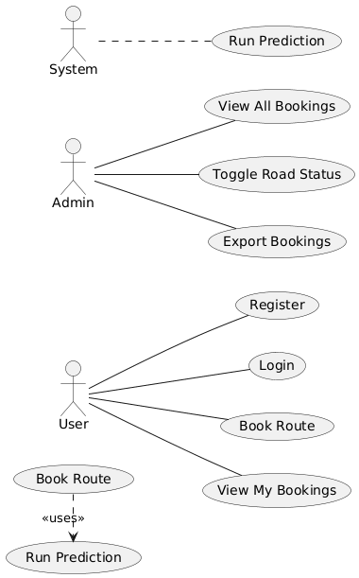
USE CASE DIAGRAM
>Shows actors and their high-level interactions with the system
4 November 2025

Slide 11
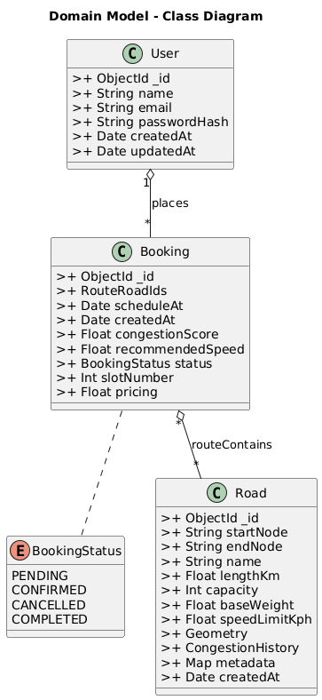
CLASS DIAGRAM
>Defines backend classes/models with visibility and relationships
4 November 2025

Slide 12
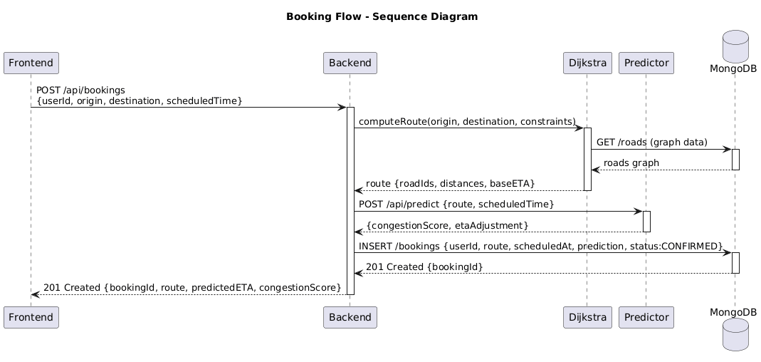
SEQUENCE DIAGRAM
>Time-ordered message flow for booking
4 November 2025

Slide 13
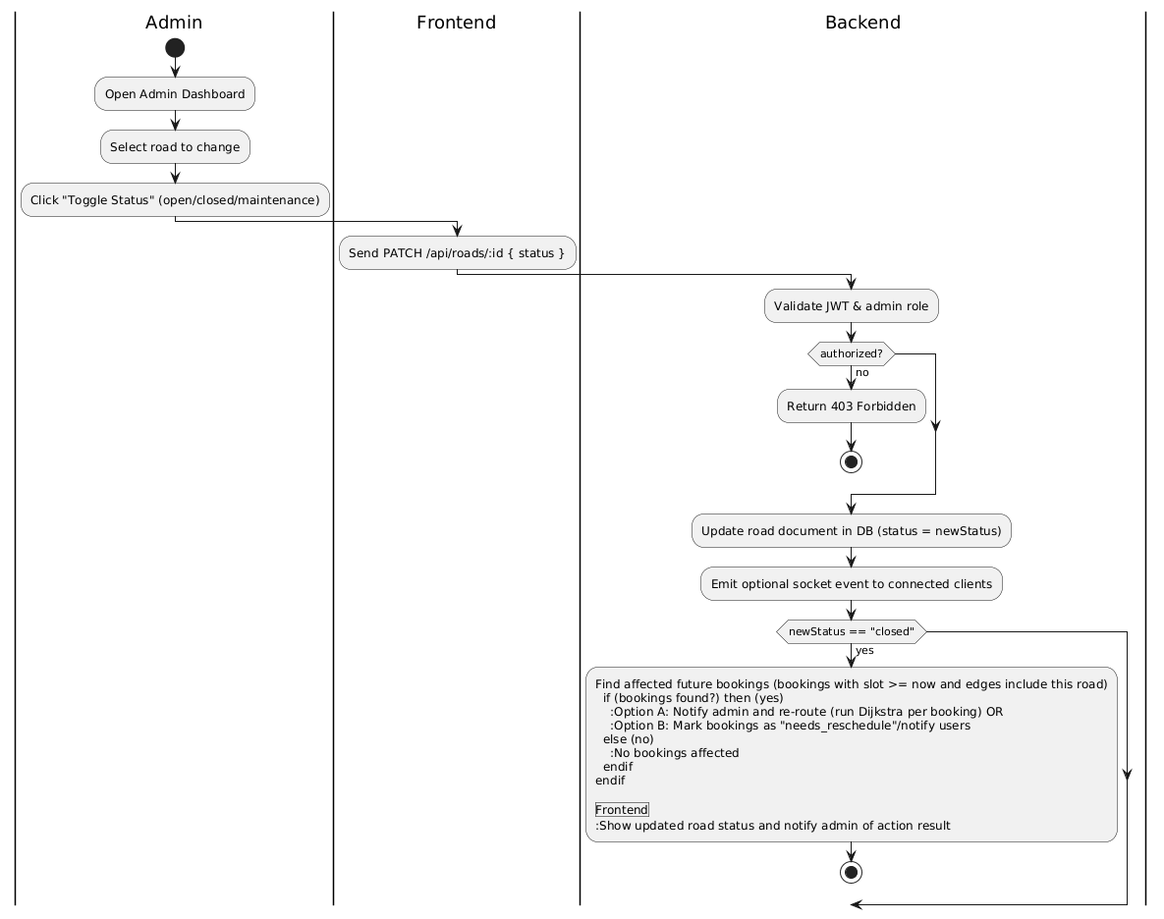
ACTIVITY DIAGRAM
>Workflow and decision points for booking
4 November 2025

Slide 14
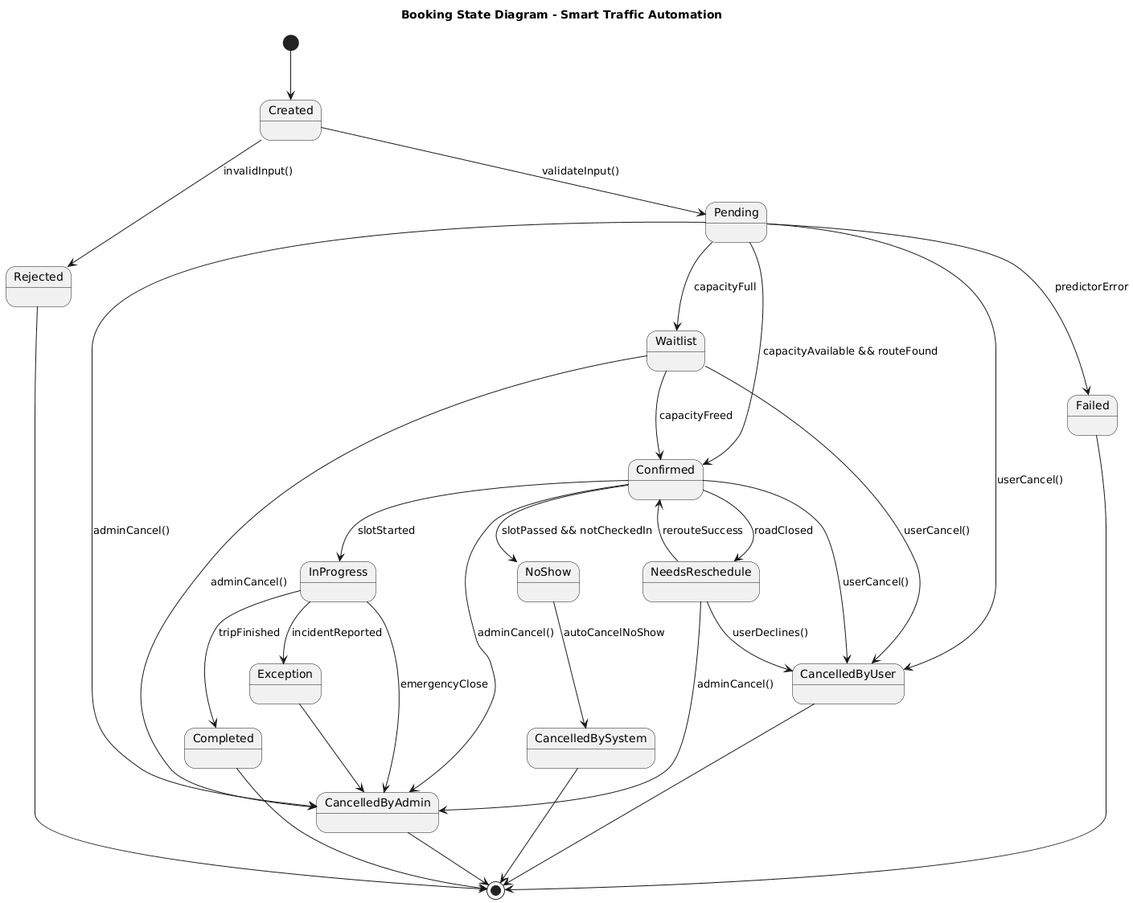
STATE DIAGRAM
>States and transitions of a booking
4 November 2025

Slide 15
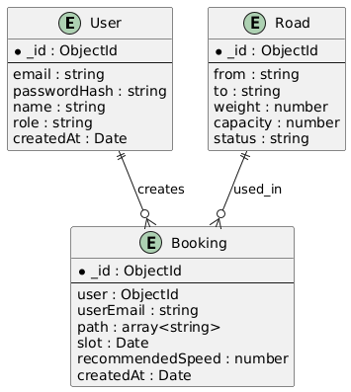
ER DIAGRAM
>Data entities and relationships plus primary data flows for booking creation and reporting.
4 November 2025

Slide 16
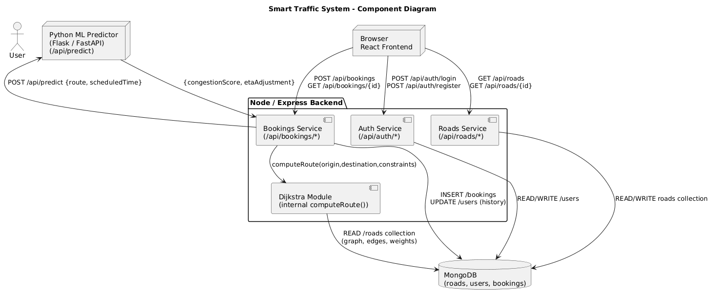
COMPONENT DIAGRAM(HLD)
>High-level components and their interfaces
4 November 2025

Slide 17
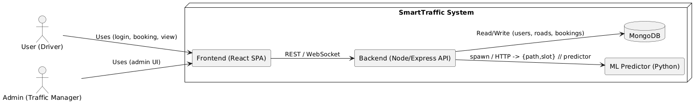
SYSTEM CONTEXT DIAGRAM(HLD)
Users and Admin interact with React SPA which calls REST API
API interacts with MongoDB and Python ML predictor
4 November 2025

Slide 18
IMPLEMENTATION
Data Collection: Road network seeded using a JSON graph generator (67 nodes, weighted edges with capacity and status fields)
Database Method: Used MongoDB with Mongoose ODM for schema validation and CRUD operations
Collections & Structure: Three collections — Users, Roads, Bookings: Each document stores flexible JSON (BSON) data with indexed fields
Queries Implemented: Optimized CRUD and aggregation pipelines for login validation, booking creation, slot occupancy, and admin exports
Data Integrity & Security: Passwords hashed with bcrypt, JWT-based auth for API access, and referential consistency maintained via user–booking references.
Department of Artificial Intelligence & Data Science
4 November 2025

Slide 19
OVERVIEW
Tech Stack: React, Node.js + Express (Backend API), MongoDB (Database), Python (ML Predictor)
Architecture: Modular 3-tier design — Frontend → REST API → Database & ML Service ensures scalability and easy debugging
Development Ideology: Followed Iterative Agile model — core booking module first, followed by ML, admin, and performance enhancements
Data Flow: User request → Node API → Dijkstra routing → Python predictor → MongoDB save → Response with route & speed.
Department of Artificial Intelligence & Data Science
4 November 2025

Slide 20
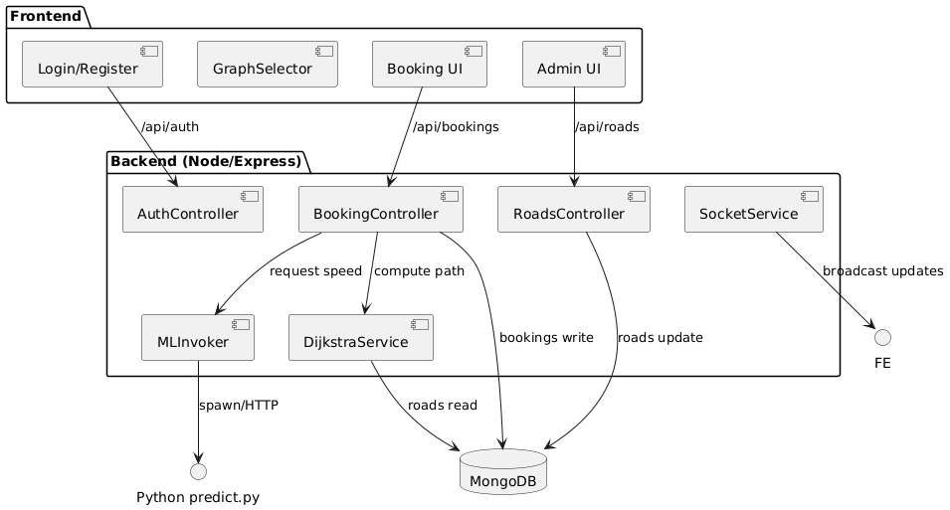
BLOCK DIAGRAM
4 November 2025

Slide 21
RISKS
Security — user data exposure (weak hashing / leaked JWT).
Usability — confusing graph selector or inconsistent UI.
Performance — slow Dijkstra or blocking ML predictor; UI lag on low-end devices.
Requirement — scope creep or unclear ML expectations.
Schedule — frontend/backend integration delays (CORS, API mismatch).
Department of Artificial Intelligence & Data Science
4 November 2025

Slide 22
Risk | Likelihood | Impact | Mitigation strategy
Security — user credential leak or weak hashing | Medium | High | Use bcrypt with salt, store JWT secret in env, validate inputs, run simple security checks before demo.
Usability — confusing graph selector / UI | Medium | Medium | Improve visual affordances, provide keyboard fallback, add small help tooltip and onboarding text.
Performance — ML blocking backend or slow Dijkstra | Medium | High | Use heuristic fallback when ML fails; optimize Dijkstra; limit graph size for demo; profile and optimize critical code paths.
Requirement changes — scope creep | Medium | Medium | Freeze MVP feature list before each sprint; document change requests and impact on schedule.
Schedule — integration / build errors | High | Medium | Prepare seed data, use environment checklist, do early integration tests, keep simple hardcoded fallbacks for demo.

Slide 23
TESTING
Verify core flows: register, login, book route, admin operations
Validate UI usability and graph interactions
Ensure bookings persist with correct path, slot and recommended speed
Approach: Unit tests, Integration tests, Manual UI tests
Confirm ML fallback works so booking still succeeds on predictor failure
4 November 2025

Slide 24
Feature tested | Test description | Expected result | Actual result
User registration | Submit valid name, email, password via /register | New user created, JWT returned, redirected to booking page | Pass
Login with invalid credentials | Wrong password attempt | HTTP 401, error message, no token saved | Pass
Booking creation (happy path) | Select source & destination, optional slot, click calculate | POST /api/bookings/book returns booking with path and recommendedSpeed; DB record created | Pass
Admin view all bookings | Login as admin, open dashboard | Admin sees all bookings including new ones; export works | Pass
Toggle road status (admin) | Admin sets road to closed then open | Road status updated in DB and UI; Dijkstra excludes closed edges | Pass
UI graph interaction | Click nodes to select source and destination (keyboard fallback) | Node selection updates UI and hidden form values; works across browsers | Pass

Slide 25
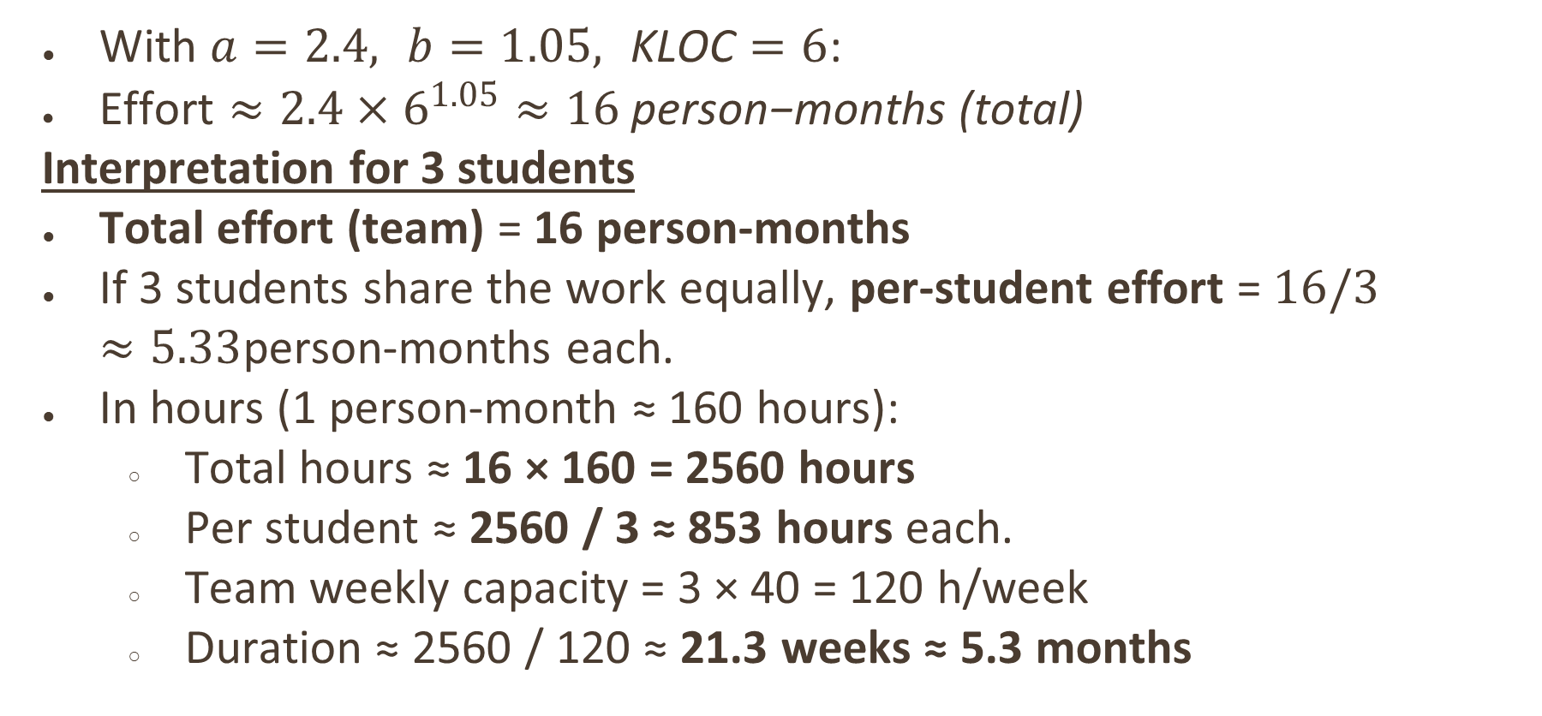
COCOMO ESTIMATION
With $a=2.4, b=1.05, \text{KLOC}=6$:
$\text{Effort}≈2.4×6^{1.05}≈16 \text{person}\text{−}\text{months}\text{ (}\text{total}\text{)}$
Interpretation for 3 students
Total effort (team) = 16 person-months
If 3 students share the work equally, per-student effort = $16/3≈5.33$person-months each.
In hours (1 person-month ≈ 160 hours):
Total hours ≈ 16 × 160 = 2560 hours
Per student ≈ 2560 / 3 ≈ 853 hours each.
Team weekly capacity = 3 × 40 = 120 h/week
Duration ≈ 2560 / 120 ≈ 21.3 weeks ≈ 5.3 months
4 November 2025

Slide 26
FUNCTIONAL POINTS
Count summary:
EI (inputs) = 4 (register, login, book, update road)
EO (outputs) = 3 (booking result, road list, CSV)
ILF (files) = 3 (users, roads, bookings)
UFP estimate: ~12; adjusted FP ≈ 28
Interpretation: FP gives a function-based size measure useful to plan testing and documentation scope
Department of Artificial Intelligence & Data Science
4 November 2025

Slide 27
RESULTS

Slide 28
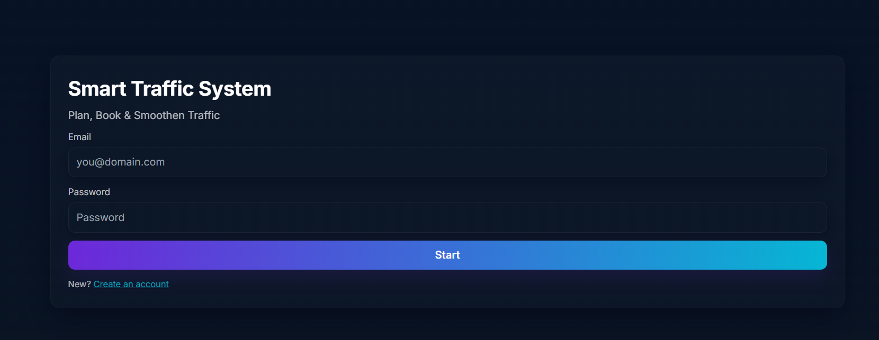
LOGIN

Slide 29
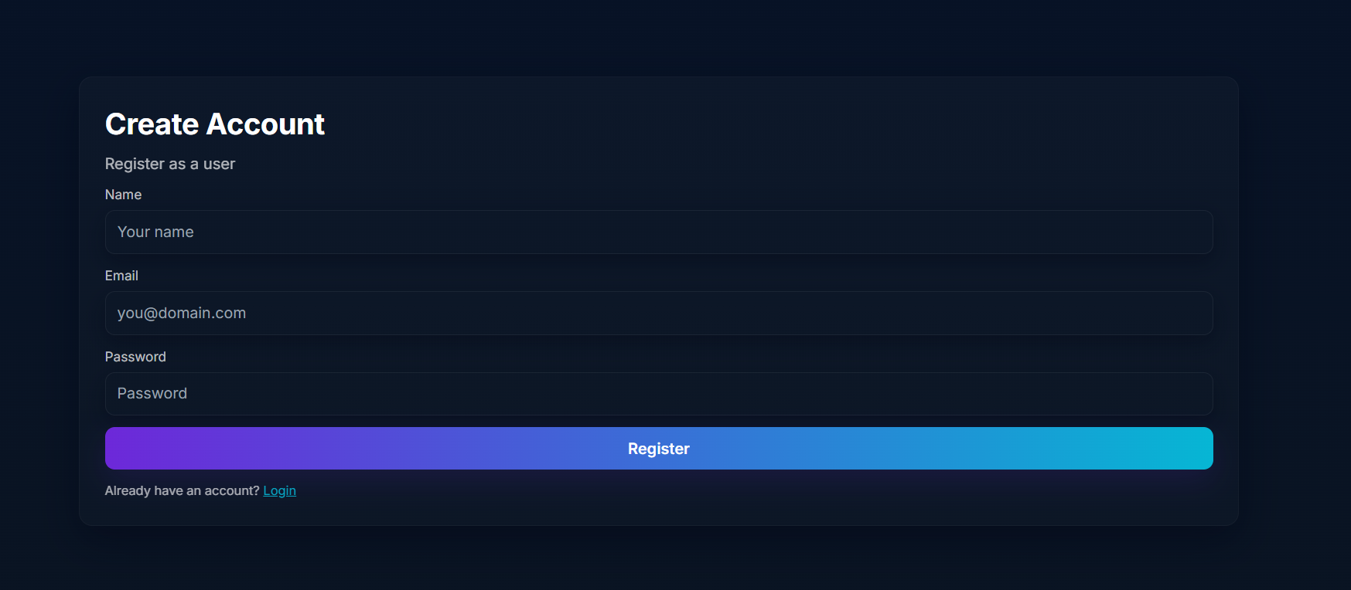
REGISTER

Slide 30
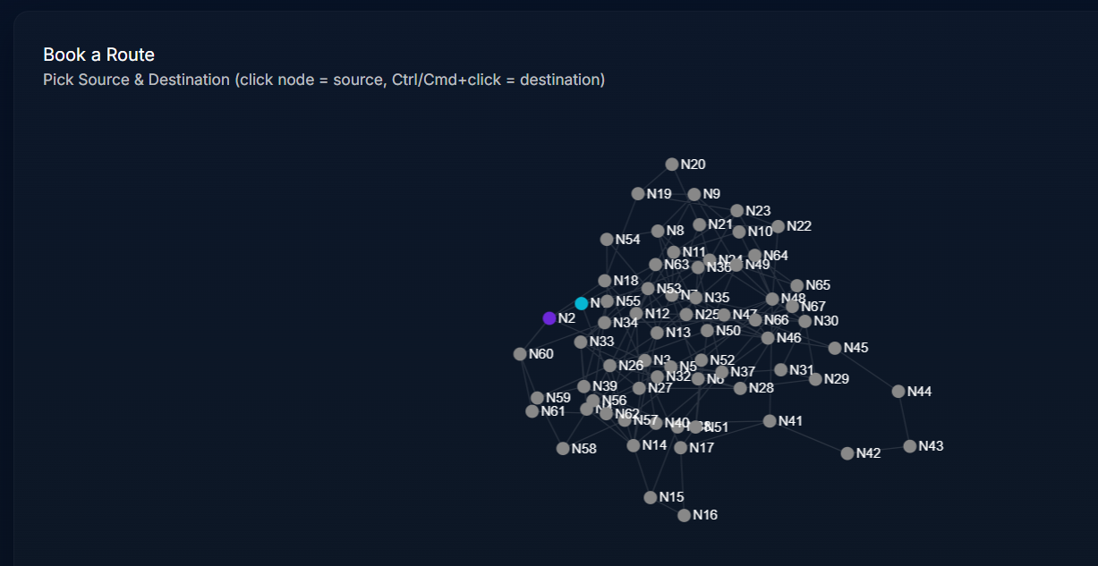
BOOKING

Slide 31
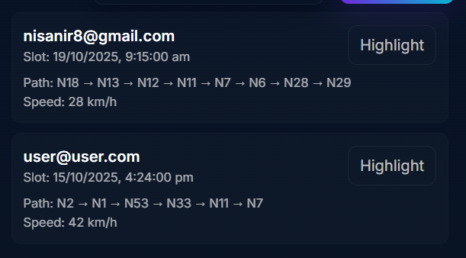
ADMIN DASHBOARD

Slide 32
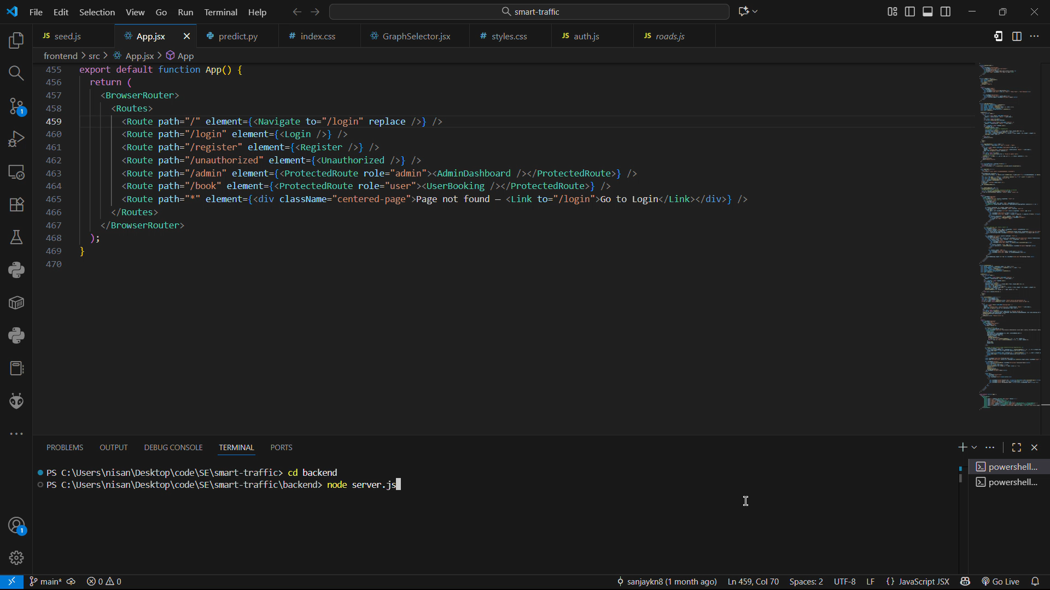

Slide 33
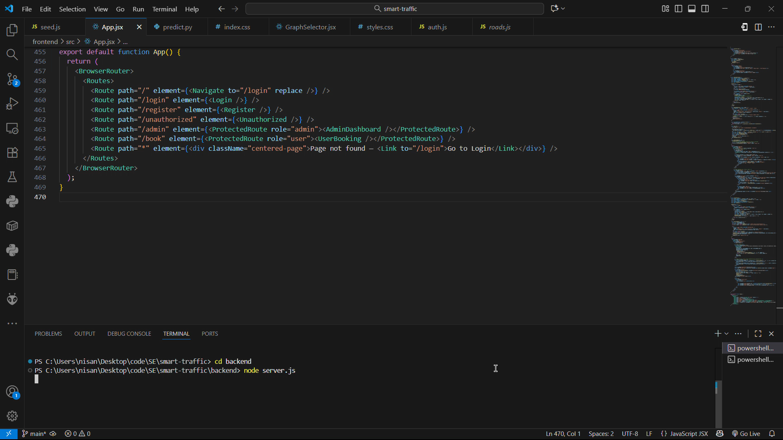

Slide 34
SOCIAL IMPACT
Positive impact: smoother traffic reduces idling and emissions, improves commute predictability and supports urban planning with recorded booking data
Ethical considerations: privacy (store minimal PII), fairness in slot allocation, transparency of ML recommendations
Governance suggestions: anonymized reporting, policies for slot distribution to avoid socioeconomic bias.
Department of Artificial Intelligence & Data Science
4 November 2025

Slide 35
CONCLUSION & FUTURE WORK
Summary: Smart Traffic Automation demonstrates a booking-driven approach to smooth traffic peaks using occupancy-aware routing and an ML predictor with a reliable fallback
Future work: scale ML to async microservice, integrate real map tiles (Leaflet), add WebSocket real-time updates, implement fairness and quota policies, add analytics dashboards
Code: https://github.com/sanjaykn8/SE_MiniProject
Department of Artificial Intelligence & Data Science
4 November 2025

Slide 36
THANK YOU

